Slide 1
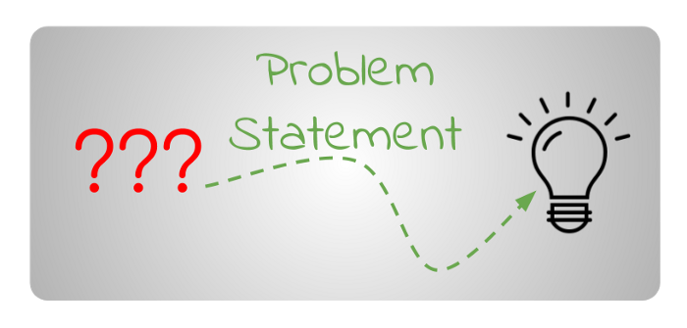
Implementation model for online toy rental shop
The Problem Statement:-
The Baby Toy Company was selling premium toys but the business had been stagnant over the years. They are looking at bringing in new offerings to increase revenue. A survey was conducted on kids and their preference for toys and it was found that attention span/engagement with a new toy lasts only few days for kids and they start demanding a new one within a week. However, the survey also brought out that parents found affording premium toys difficult. Like any business, they saw an opportunity here and decided to launch a new offering of premium toys being available on rent and directed the IT team to make rental option for customers available on their online .
To develop, manufacture, and market high quality products for children that are enjoyable for the child, have educational benefits for the child, and are a good value for the purchaser.

Slide 2
Requirement Analysis
Requirement analysis: In the first phase of the incremental model,
the product analysis expertise identifies the requirements.
Requirements from user-end:-
* New premium toys for every week
* Toys to be available at rent.
*Premium toys at reasonable prices
Requirements from stake holders:
* To increase revenue
* To increase number of users.

Slide 3
Design & Development
In this phase of the incremental model of SDLC, the design of the system functionality and the development methods are finished.
application will have 3 types of access or interfaces:
Public User Interface
Register User Interface
Rental Store Owner or Admin Interface
User Characteristics:
ADMIN
TOY COMPANY ADMIN
USER

Slide 4
TESTING PHASE
The testing phase of the incremental model checks the behavior of each existing function in the system under
development as well as the additional functionality.
Several testing methods are used under this phase to check the behavior of each categorized function and
system respond.​
They are some testing phase in incremental model​
1. unit testing: Developer done unit testing code was working or not.​
2. system testing: System Testing is basically performed by a testing team that is independent of the
development team that helps to test the quality of the system impartial.​
3. acceptance testing : is an end user testing it's a use acceptance testing ​

Slide 5
THE CODING PHASE
1.Login and user management.
2.Fetch item details from database based on user logged in.
3.Show the available items and its details with price.
4.If user click the item, then show rental options for the item and show review of the
item.
5.If user proceeds for rental, handle the online transaction.
6.If any problems occur in transaction, notify the customer with clear and
understandable error message and rollback the transaction.
7.Update the database.

Slide 6
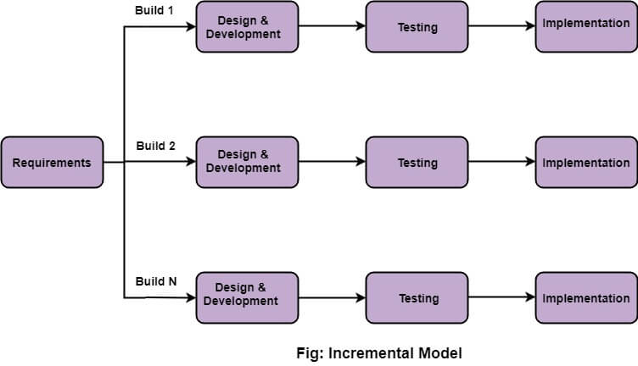
IMPLEMENTATION PHASE
Implementation phase
enables the coding
phase of the
development system for
the Rental Toy Shop. It
involves the final coding
that design in the
designing and
development phase and
tests the functionality in
the testing phase. After
completion of this
phase, the number of
the product working is
enhanced and upgraded
up to the final system
product

